Slide 1

A Time Series Analysis for Stock Price Prediction
Student:
Instructor:
Date:
Lina Arustamyan
Vahram Ghushchyan
02/05/2020

Slide 2
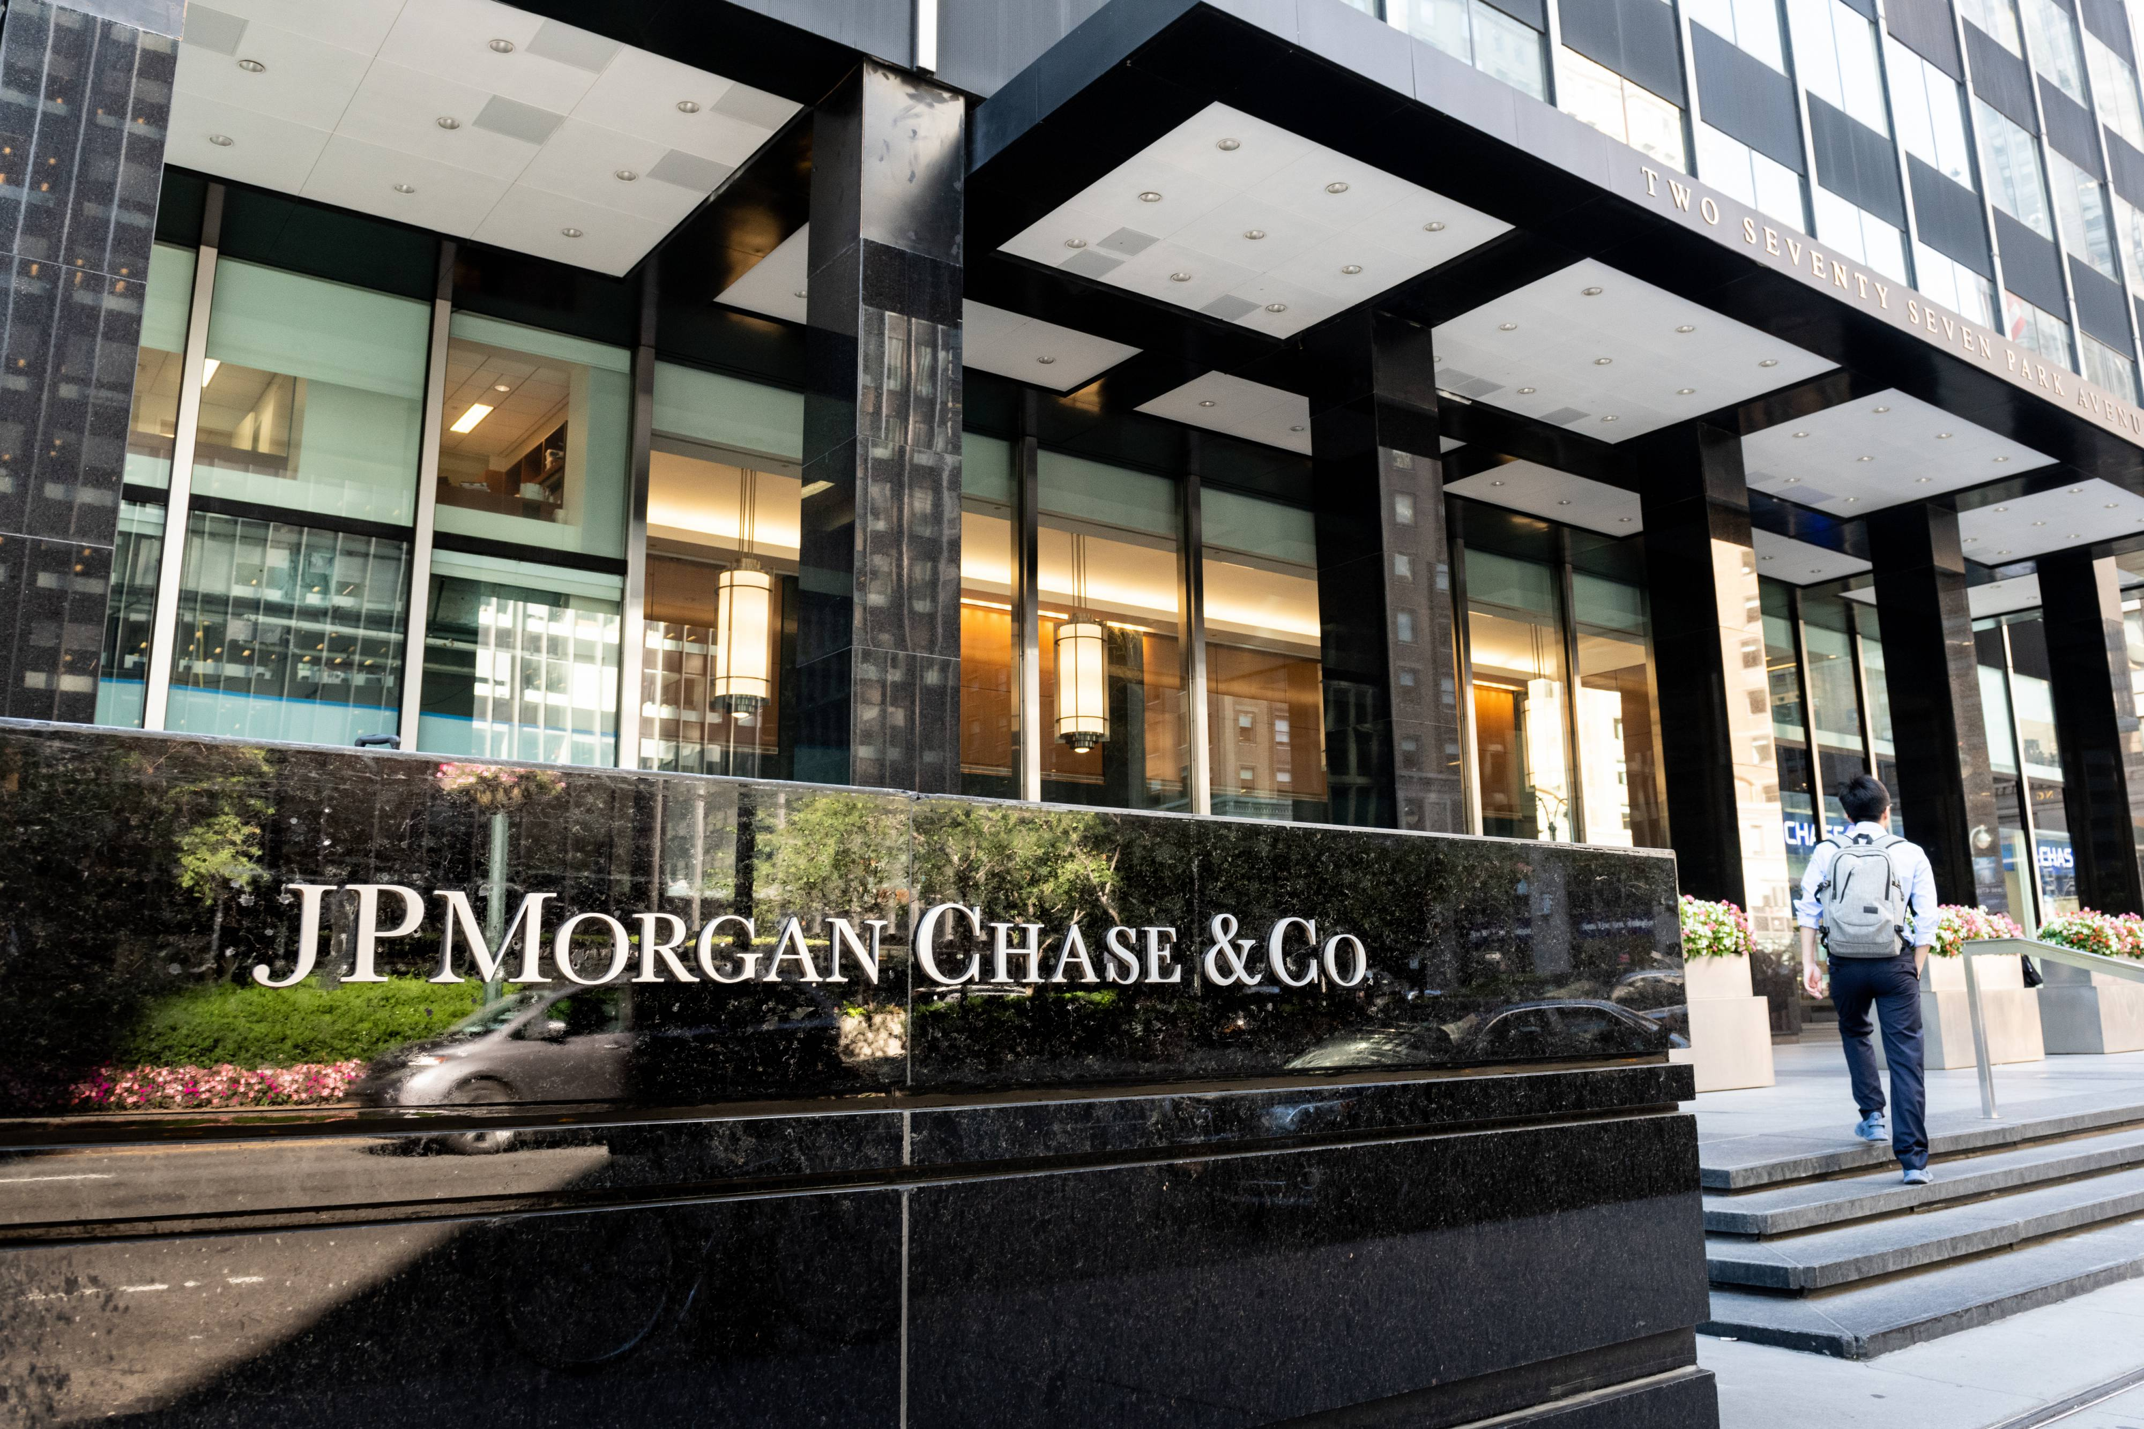
Why JPMorgan Chase & Co?
American multinational investment bank and financial services holding company
Built on the foundation of more than 1,200 predecessor institutions starting from 1799
Universal and a custodian bank
Component of the Dow Jones Industrial Average
One of America's Big Four banks
First went public on December 30, 1983 at an IPO price of $10.00
Have the third largest hedge fund in the world under management

Slide 3
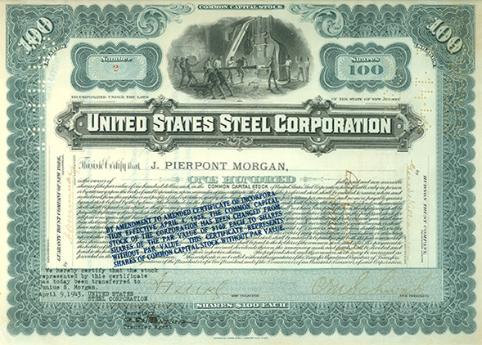
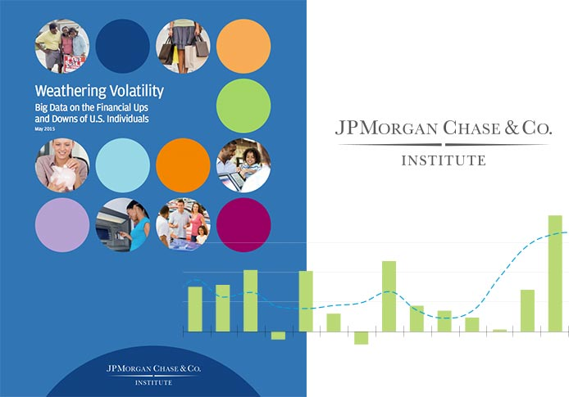
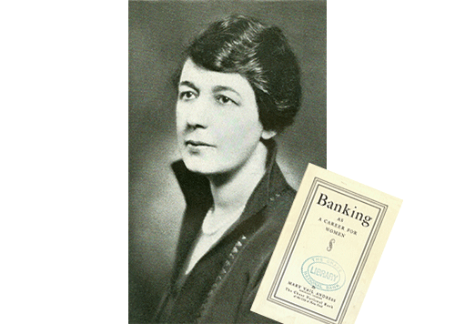

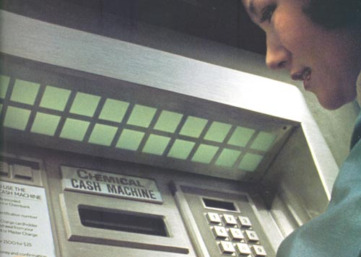

Interesting facts
2015
Establishing the JPMorgan Chase Institute
Global think tank dedicated to delivering data-rich analyses
1901
Creating the First Billion-Dollar Company
Combine 33 companies to create United States Steel
1924
Advancing Women in Finance
Chase was the first large New York City bank to hire a female officer in its main office.
2019
Replacement of traders by robots
Traders working with "incomplete lot“ were replaced by robots
1969
Pioneering the ATM
The United States’ first prototype cash dispensing machine, a precursor to the ATM
2020
Penalties and dismissal for use of WhatsApp at work
Undertakes these measures, being afraid of privacy policy violation.

Slide 4
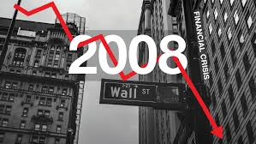

Performance during market crashes
In 2006 JPM unload the bank's subprime mortgage exposure and stop underwriting the riskiest types of mortgage-backed derivatives.
In march 2008 was so strong that the government asked it to rescue the then- floundering Bear Stearns. Six months later, it did the same with Washington Mutual.
Provided more than $100 billion to local governments
Lend more than $80 billion to Lehman after its bankruptcy
$6.8 billion addition to loan loss provisions
Earnings per share of $0.78 for the first quarter dramatically missed expectations
Net income dropped by nearly 70% from the same quarter in 2019
First-quarter revenue was only 3% lower than in the first quarter of 2019
Stock price as of May 01 was $93.25, which is nearly 20% lower than in the beginning of 2020.

Slide 5
Where it stands today
Employees
over 250,000
Total revenue (2019)
$118,7 billion
Net Income(2019)
$36,43 billion
Assets
$2.7 trillion
Liabilities
$2.43 trillion
Return on Assets
1.3%
Return on Equity
14.9%
EPS
$10.72
Stock price
(Current vs 2010)
$96.85 $32.83

Slide 6
Data & Methods
Graph 1: Monthly adjusted log prices
The time-series data for both JPM and DJI performs characteristics of random walk model with ”wandering’’ behavior.

Slide 7
Data & Methods
Graph 2: Monthly adjusted log prices after making the data stationary by first degree differencing
The time-series data for both JPM and DJI already demonstrates stationarity. Stationarity was checked by ADF test.

Slide 8
Models
Lag selection methods
AIC/BIC(small)
Significance level
Small Standard error of regression
Economic meaning
High Adjusted R^2
ARMAX(1,1)
GARCH(1,1) – ARMAX(0,1)
GARCH(1,1) – ARMA(0,1)
ARCH(2) – ARMA(1,1)
GARCH(1,1)

Slide 9
Results
Table 1: Model comparison
 | Model 1 | Model 2 | Model 3 | Model 4 | Model 5
Return on JPMorgan Chase & Co stocks | GARCH(1,1)-ARMA(0,1) | GARCH(1,1)-ARMAX(0,1) | ARMAX(1,1) | GARCH(1,1) | ARCH(2)-ARMA(1,1)
MAIN
L1.D1.ln(jpm)
D1.ln(dji)
Constant |  |  |  | 0,0089*
ARMAX
Constant | 0 .0089* | 0,007* | 0,0004 |  | 0.0105***
AR1 |  |  | 0,4333** |  | 0.8575***
MA1 | -0,0200 | -0,1438* | -0,6598*** |  | -0.9452***
L1.D1.ln(dji) |  | 0,3209** | 0,4547***
GARCH
ARCH1 | 0,1979*** | 0.1879*** |  | 0,2037*** | 0.5074***
ARCH2 |  |  |  |  | 0.2520***
GARCH1 | 0,7295*** | 0.7437*** |  | 0,7203***
Constant | 0,0005** | 0.0004** |  | 0,0005** | 0.0028***
N | 239 | 239 | 238 | 239 | 239
Log likelihood | 269,2916 | 269.597 | 274.5671 | 269,2643 | 267.4689
Mean RMSE | 0,0471021 | 0,04731 | 0,046688 | 0,046916 | 0,047301
% of correct prediction (out of 50) | 60.00% | 62.00% | 66,00% | 60,00% | 62.00%
t statistics in parentheses
* p<0.10, ** p<0.05, *** p<0.01

Slide 10

Conclusion
ARMAX(1,1) model is relatively the best one among others.
The results show that
1 unit increase in return of JPMorgan Chase & Co stocks in the previous period will increase today's return of JPM stocks by 0.4333 unit
1 unit increase in return of Dow Jones Index in the previous month will lead to an increase in return of JPM stocks by 0.4547 unit in the present month
The contribution of the error term to the return on stock price of JPM is by a factor -0.6598, which means that a positive shock in the previous month will decrease present return on stocks of JPM by 0.6598.
66% of correctly estimation of the future stock price is the key point which attracts the investors to put their capital in it.

Slide 11
Thank you for attention

